Slide 1
Model Monitoring MLflow, Tensorboard, Weights & Biases
Credit to TA.Cheetah & TA.Phu

Slide 2
Outline
Mlflow
Tensorboard
Weights & Biases

Slide 3
MLflow

Slide 4
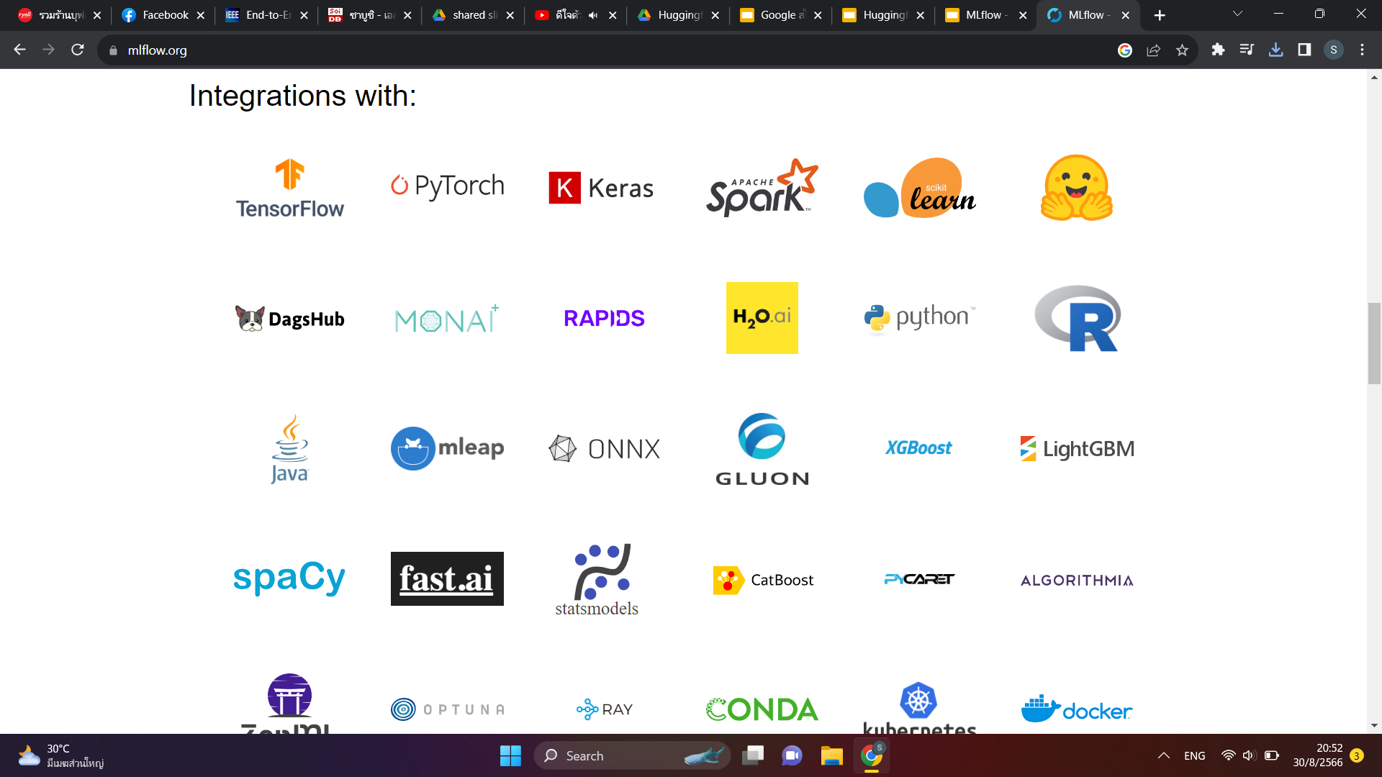
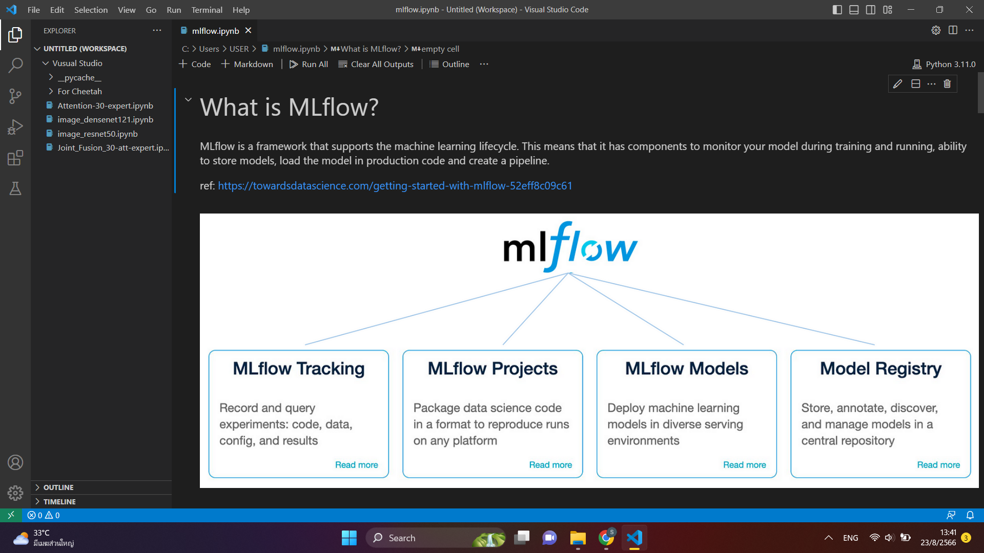
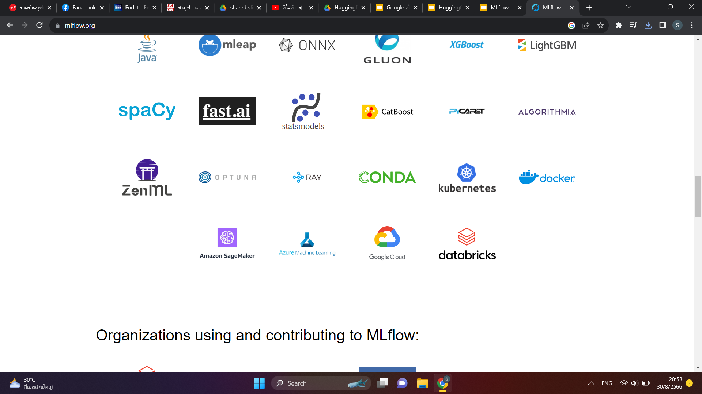
What is MLflow?
MLflow makes it simple to construct end-to-end Machine Learning pipelines in production, and this article will teach you all you need to know about the platform. This implies that at the conclusion of this tutorial, you’ll be able to utilize MLflow for Machine Learning pipelines from model experimentation through model deployment.

Slide 5
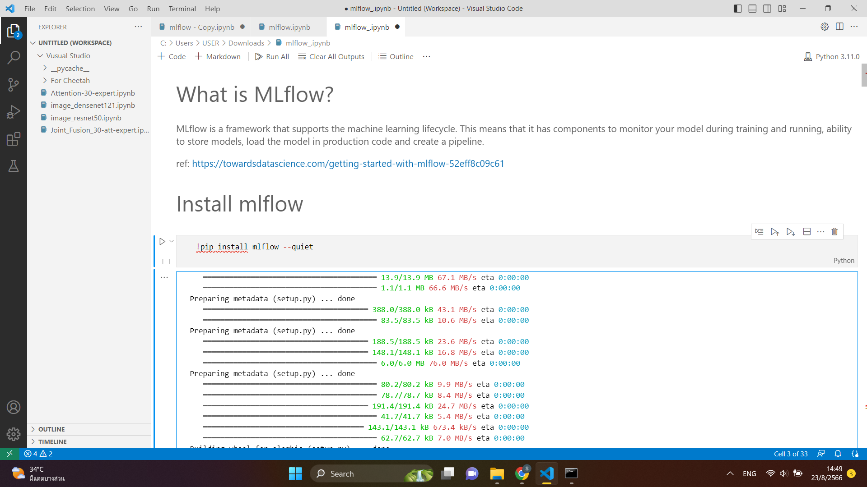
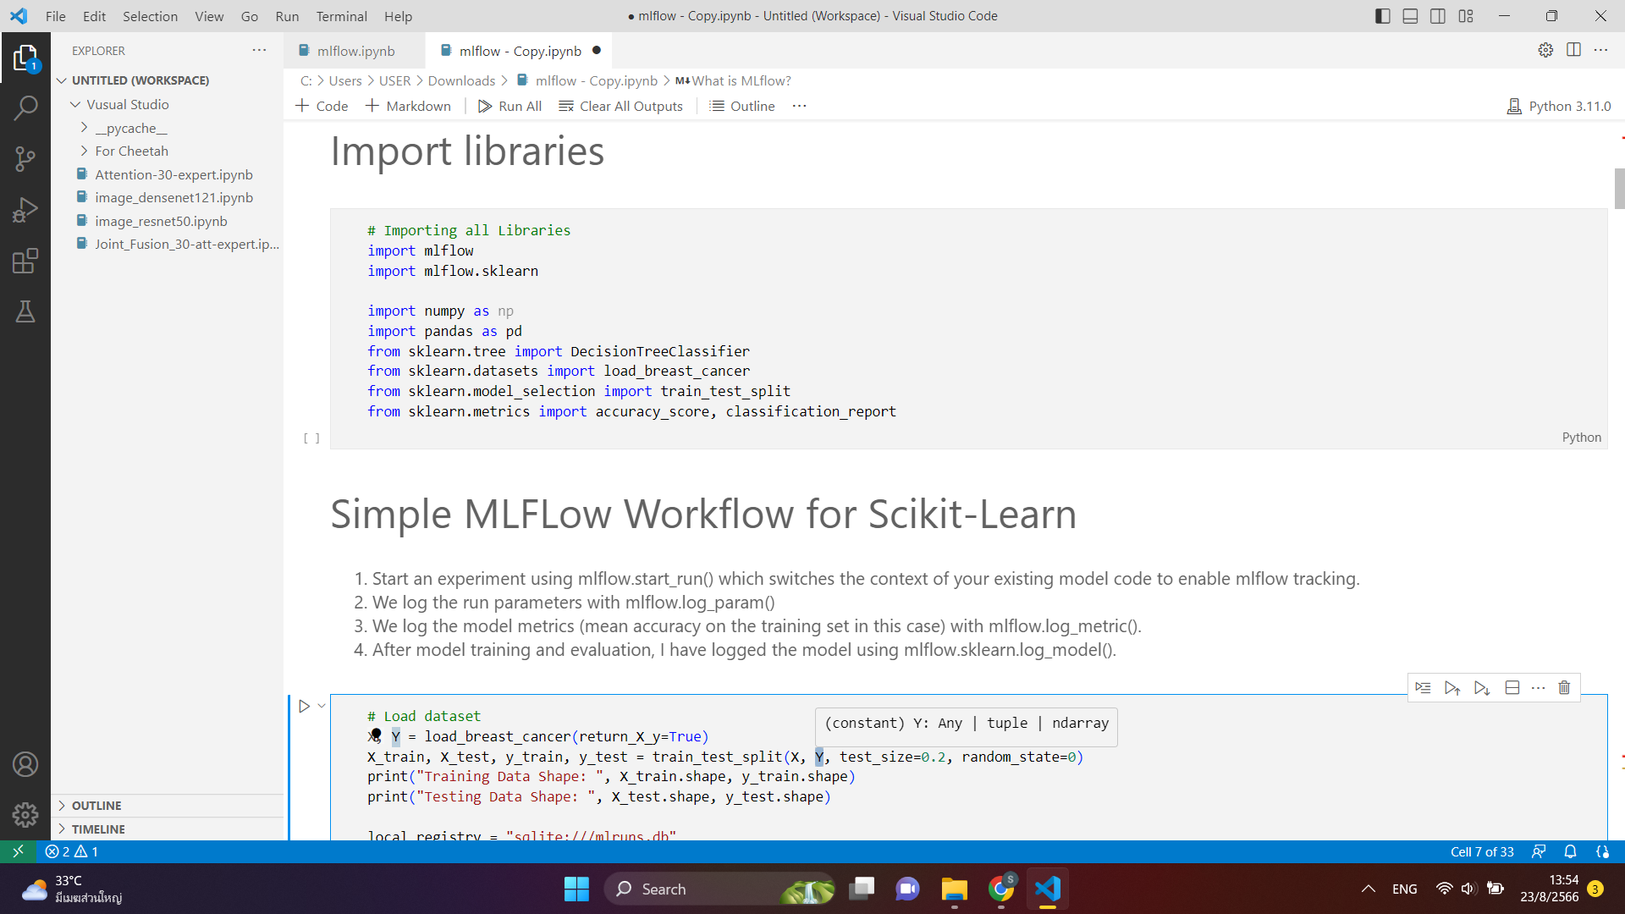
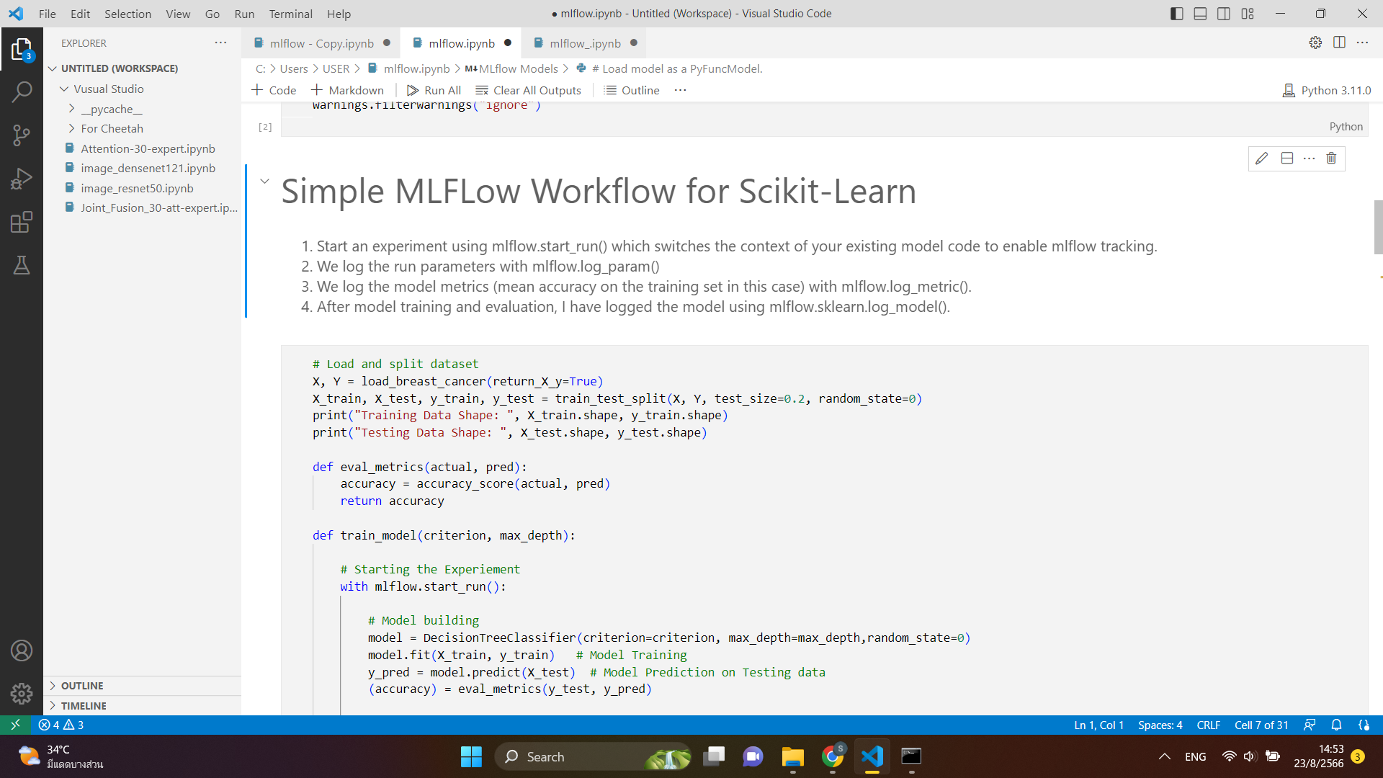
How to run MLflow
Install mlflow
Import libraries
Load dataset and define evaluation metrics

Slide 6
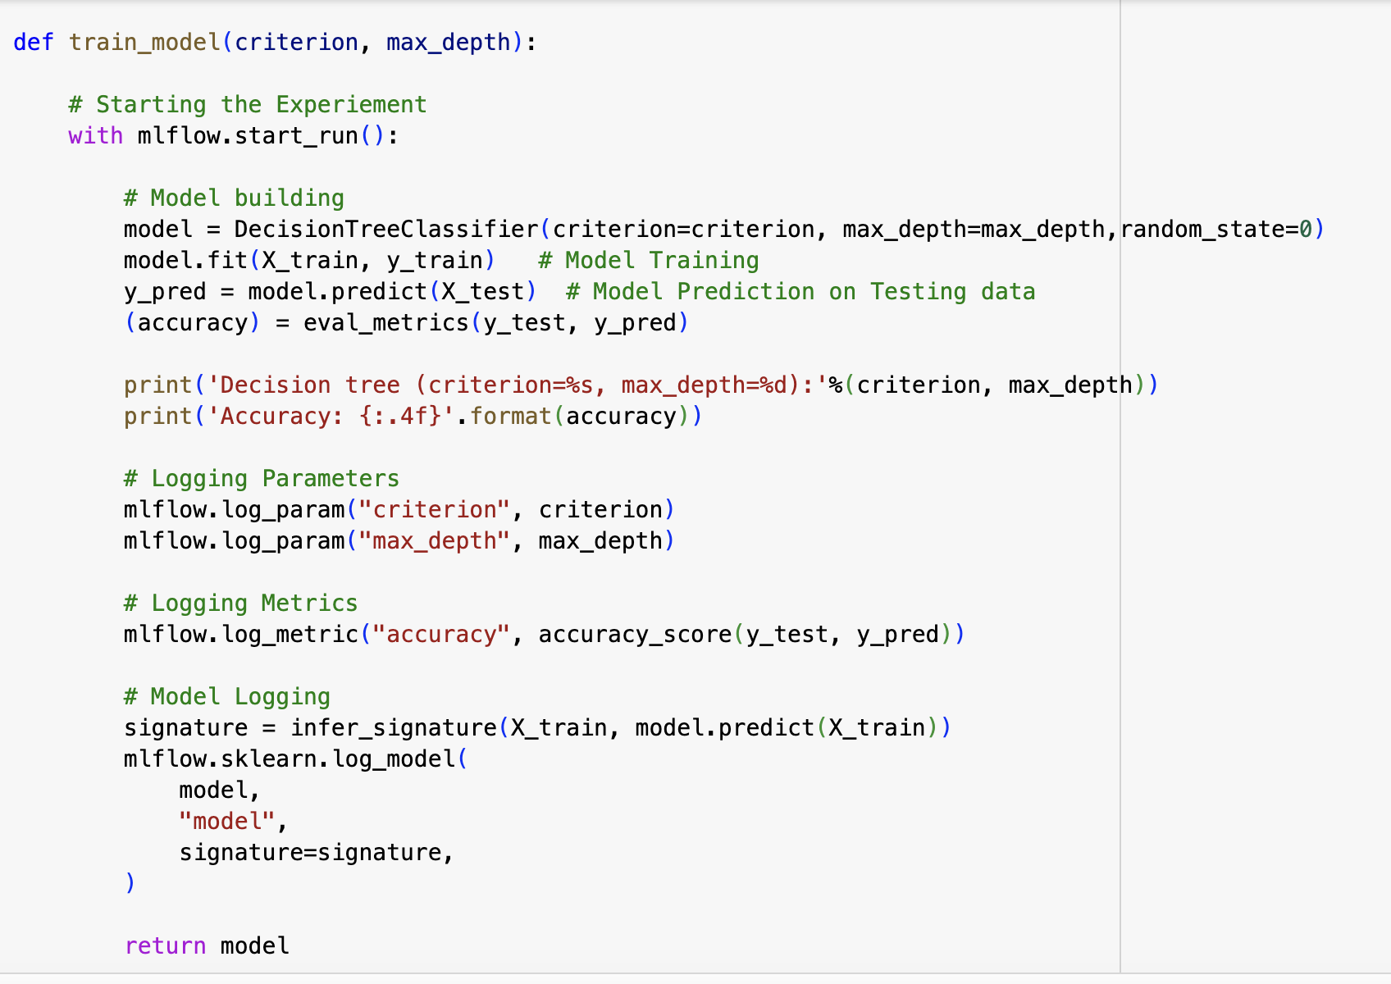
Model tracking
1. Start an experiment using mlflow.start_run() which switches the context of your existing model code to enable mlflow tracking.
2. We log the run parameters with mlflow.log_param()
3. We log the model metrics (mean accuracy on the training set in this case) with mlflow.log_metric().
4. After model training and evaluation, I have logged the model using mlflow.sklearn.log_model().
5. The model signature passed to the mlflow.sklearn.log_model(). ensures the schema of the model's input and output is accurately documented.

Slide 7
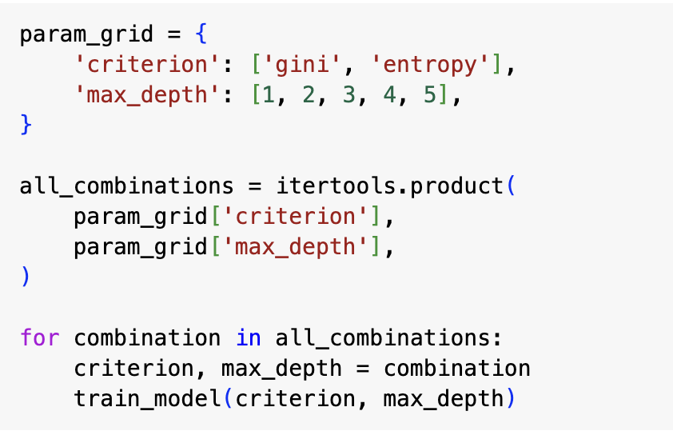
Train model and search best 5 runs
Train 10 models with different hyperparameters

Slide 8
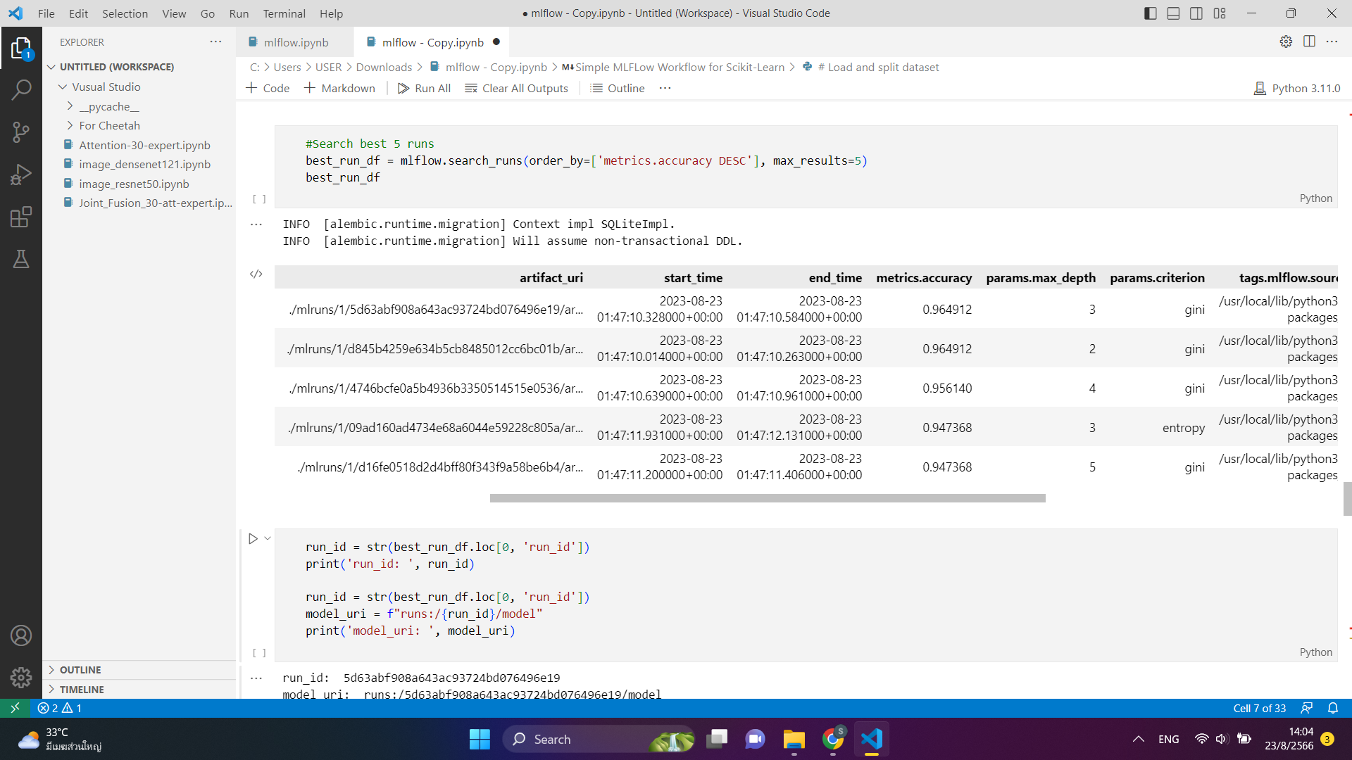
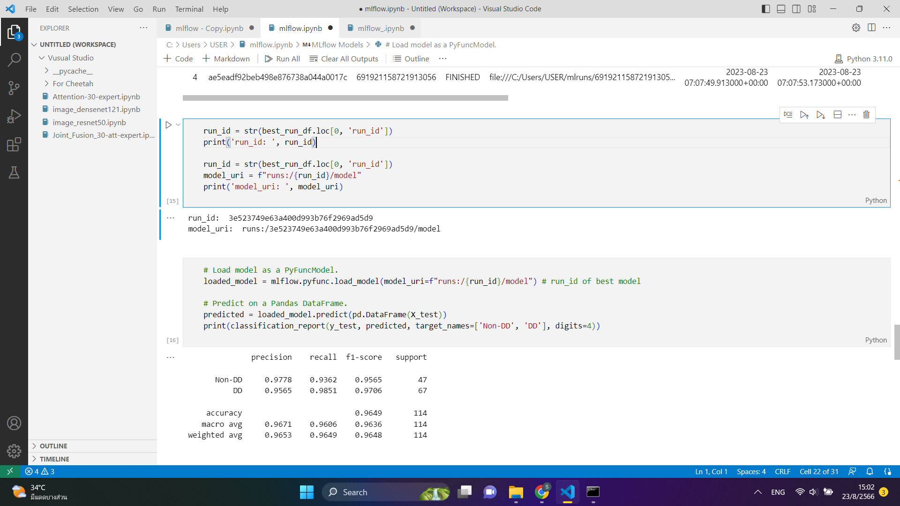
Load best model (MLflow models)

Slide 9
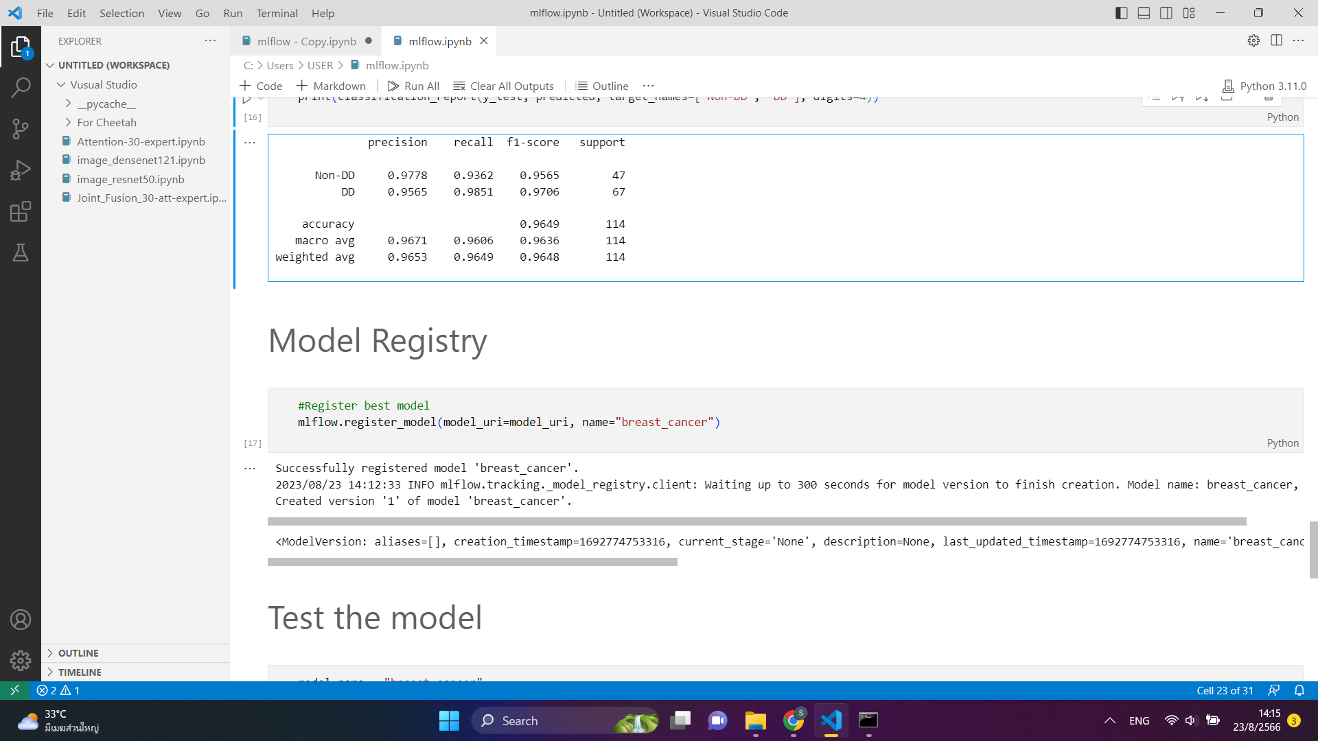
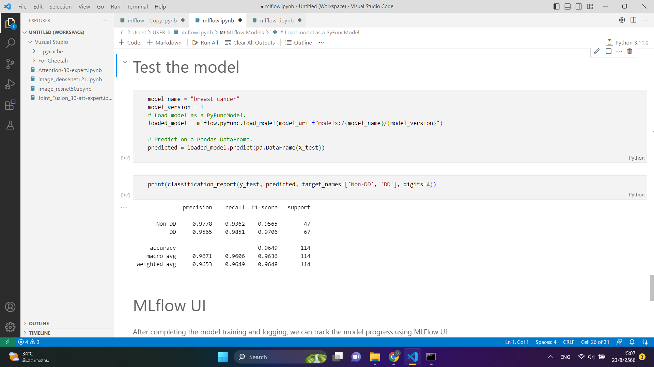
Model registry
The MLflow Model Registry component is a centralized model store, set of APIs, and UI, to collaboratively manage the full lifecycle of an MLflow Model. It provides model lineage, model versioning, stage transitions (for example from staging to production), and annotations.
Load model from registered model

Slide 10
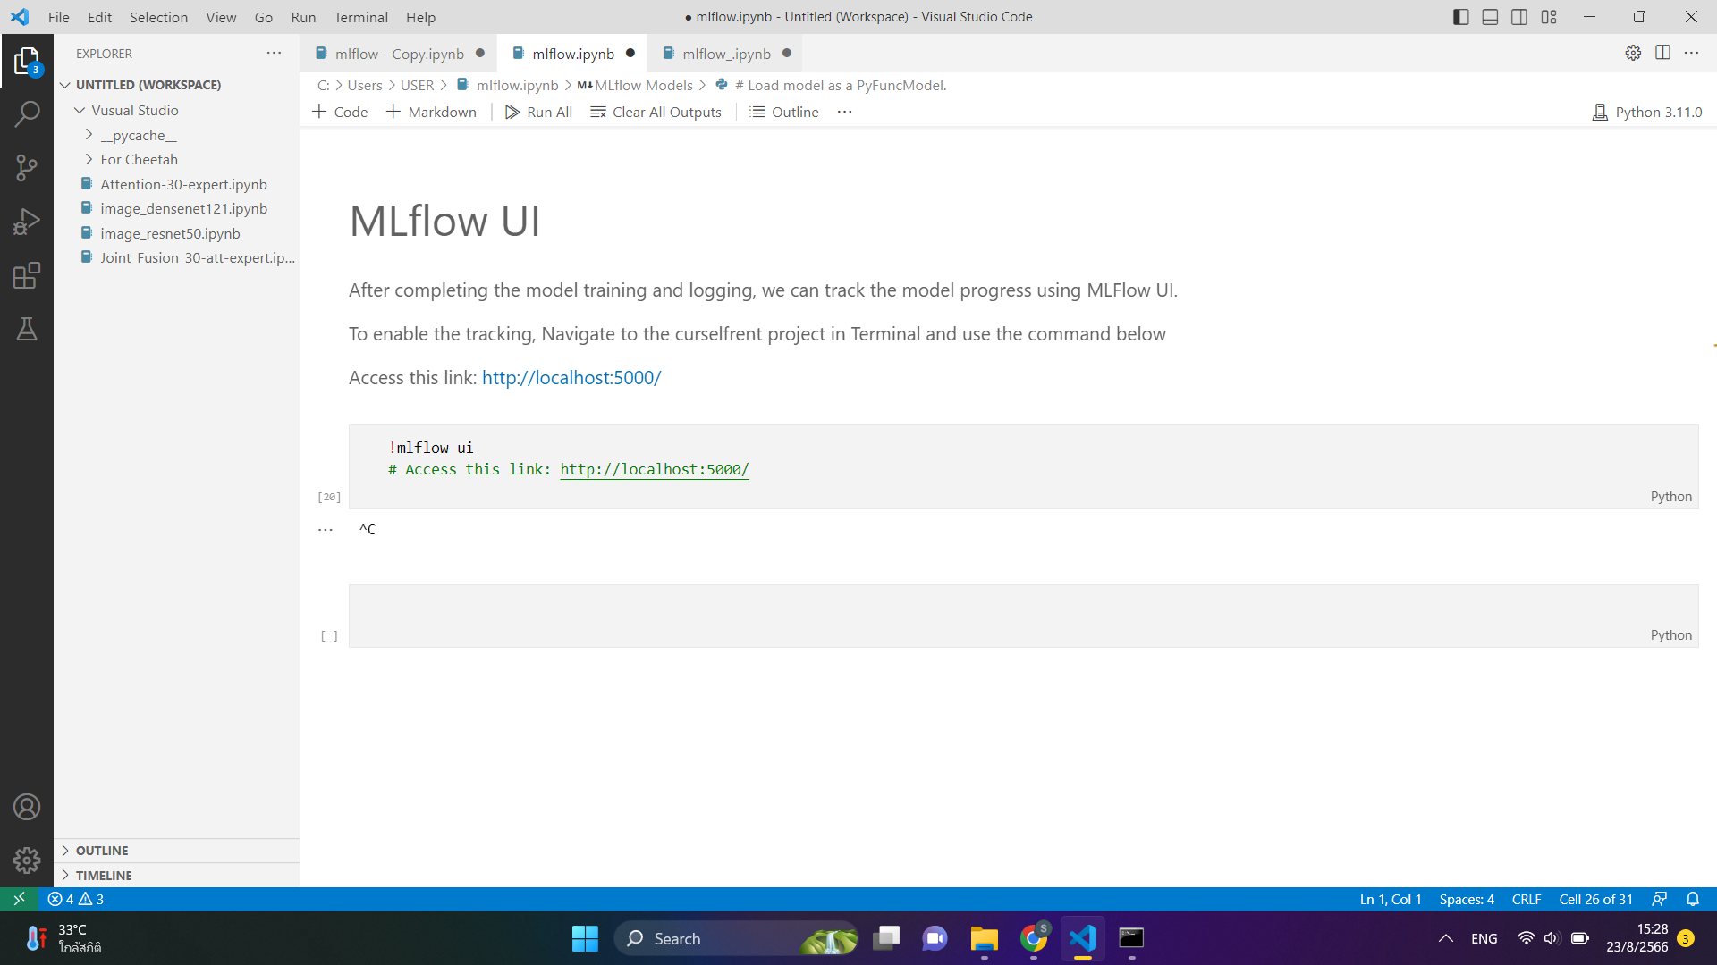
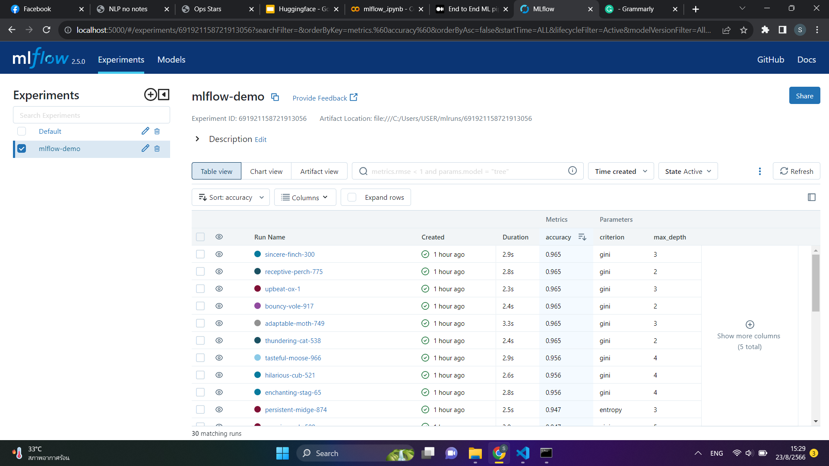
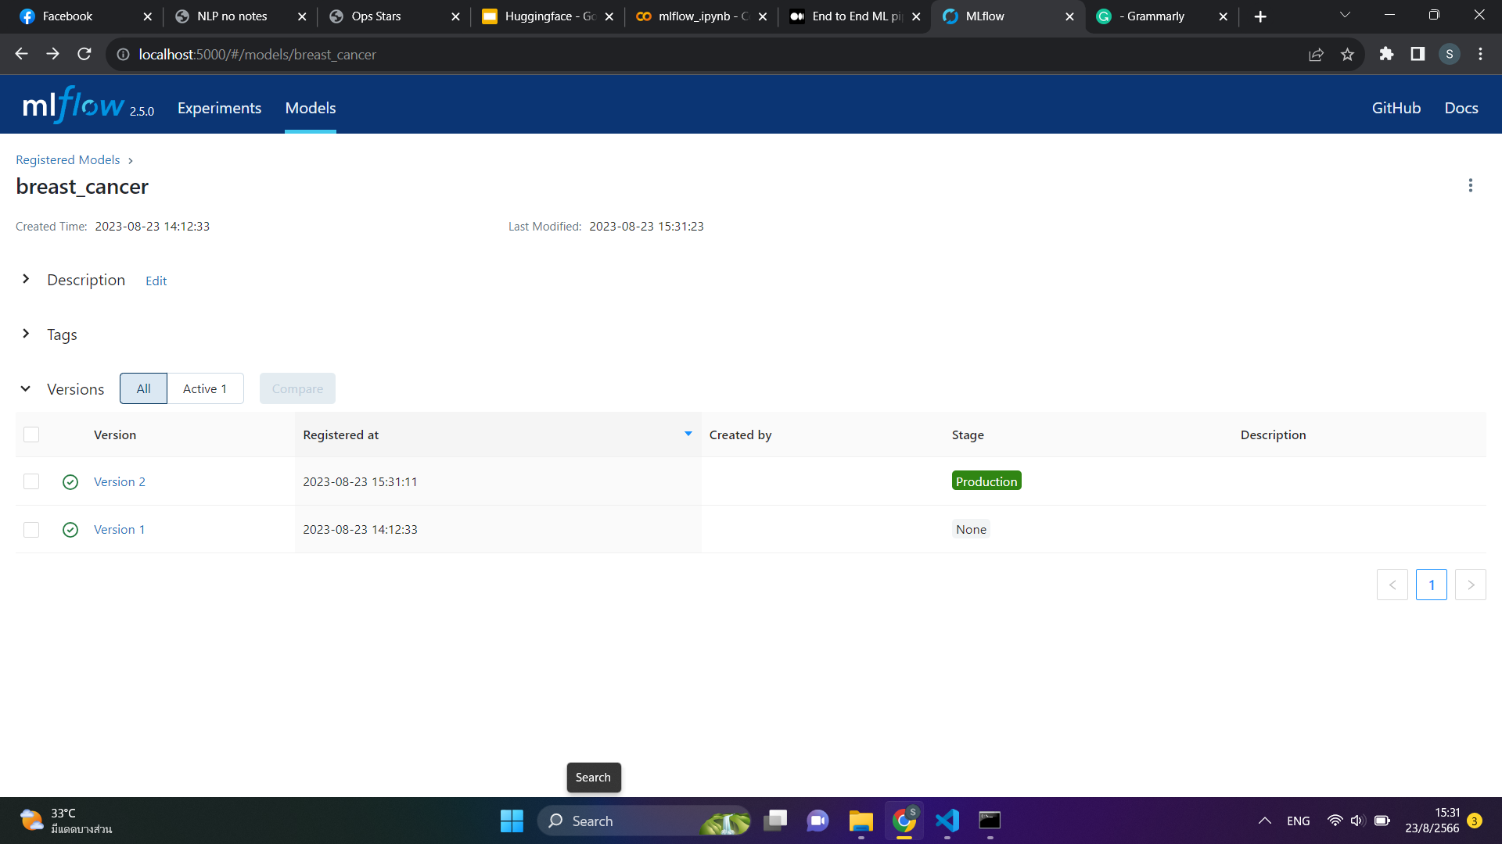
MLflow UI
View MLflow runs and experiments
Compare performance
Registered model

Slide 11
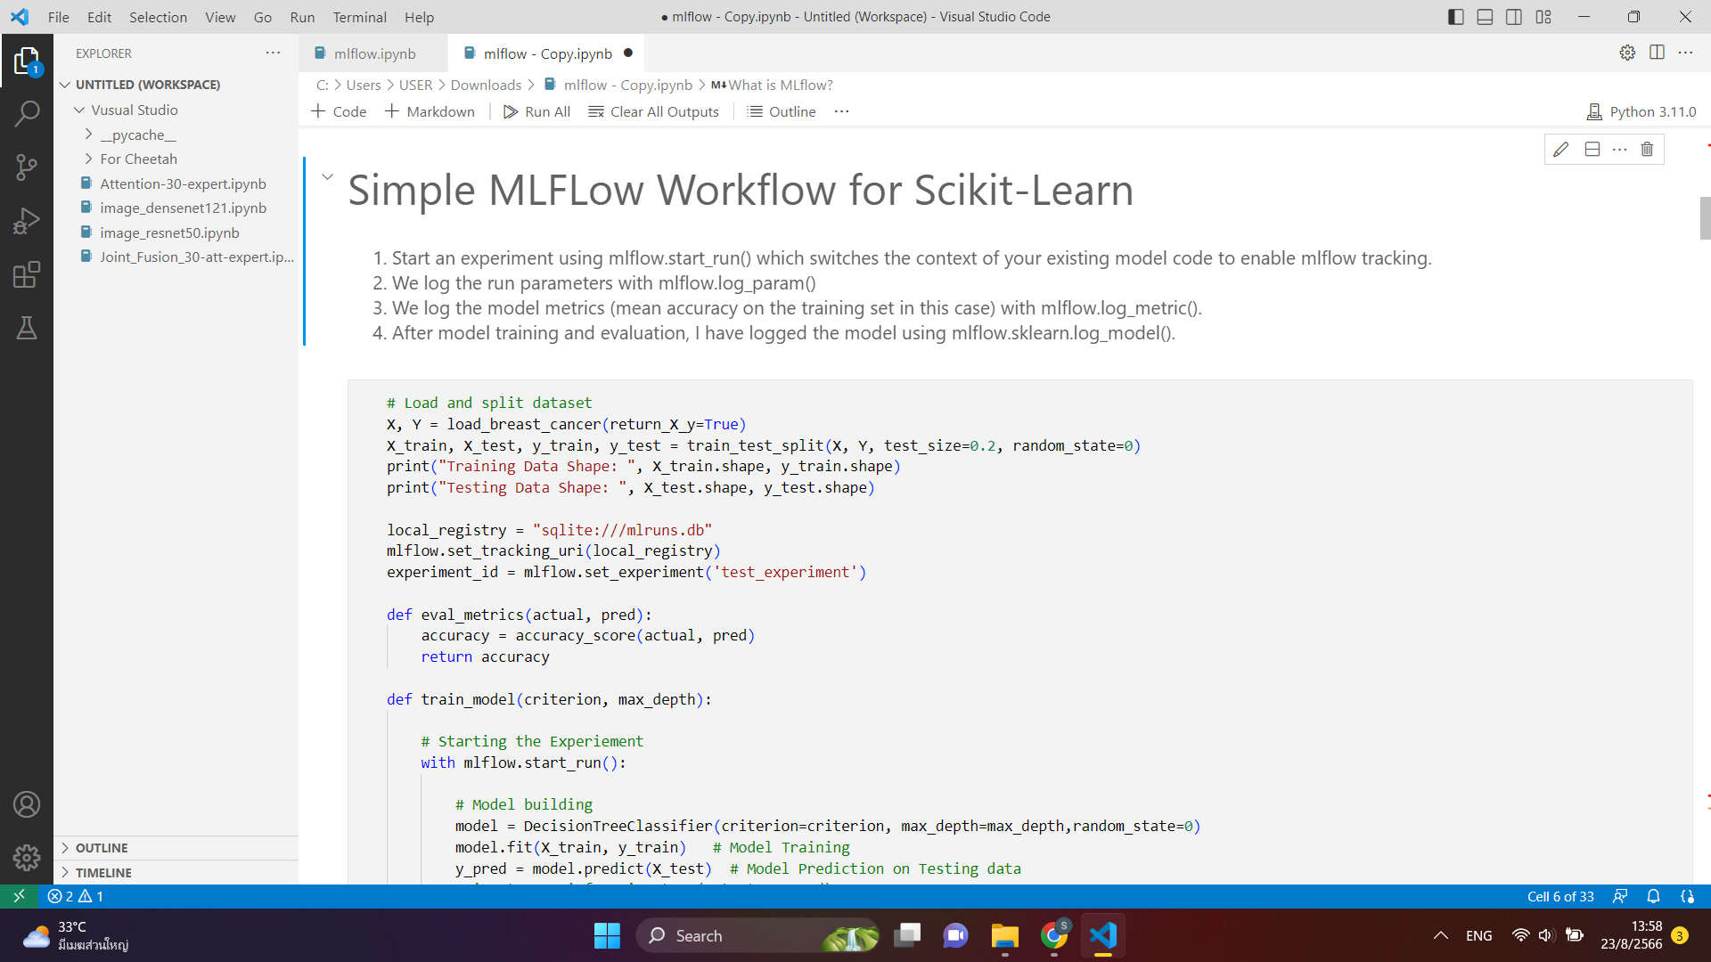
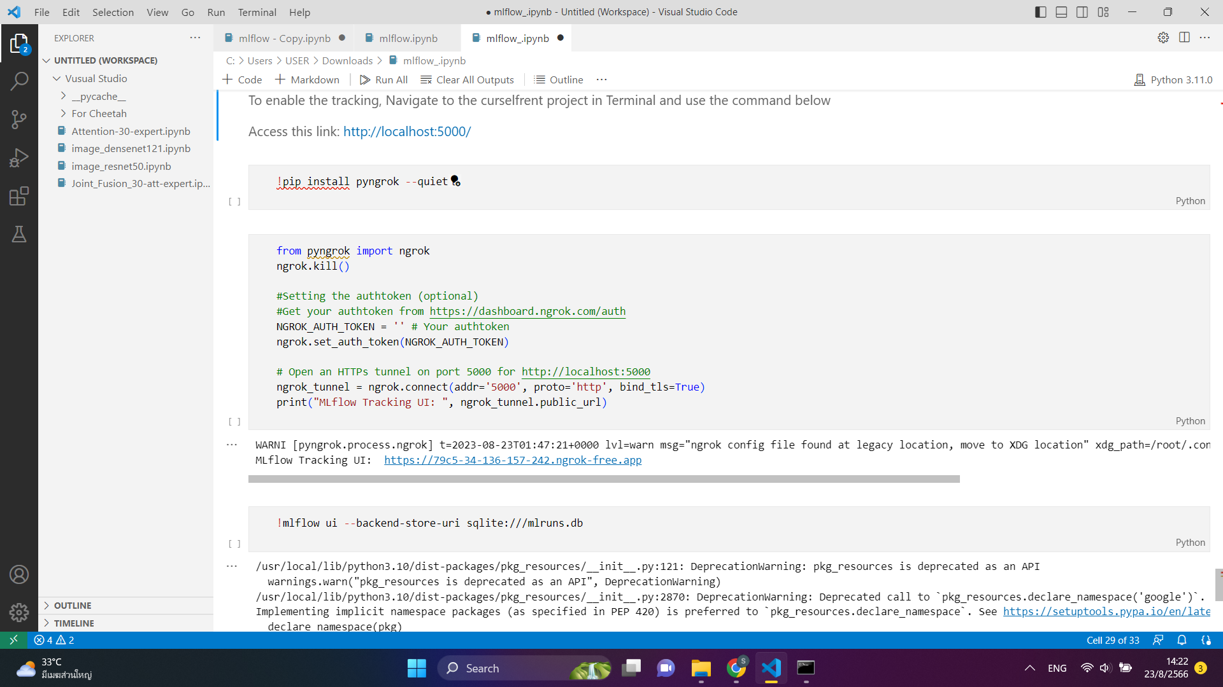
For run mlflow ui on google colab
add 3 lines before with mlflow.start_run():
Get authtoken from https://dashboard.ngrok.com/get-started/your-authtoken
access from this link

Slide 12
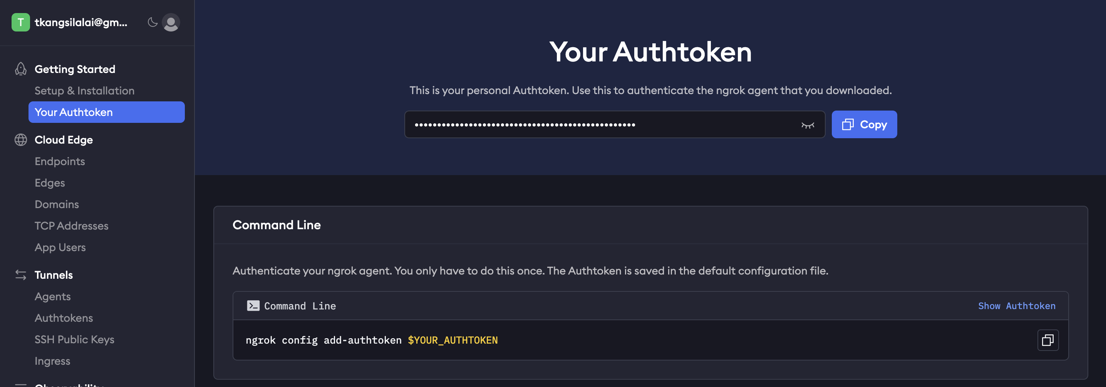
NGROK Authtoken

Slide 13
Tensorboard
Guide

Slide 14
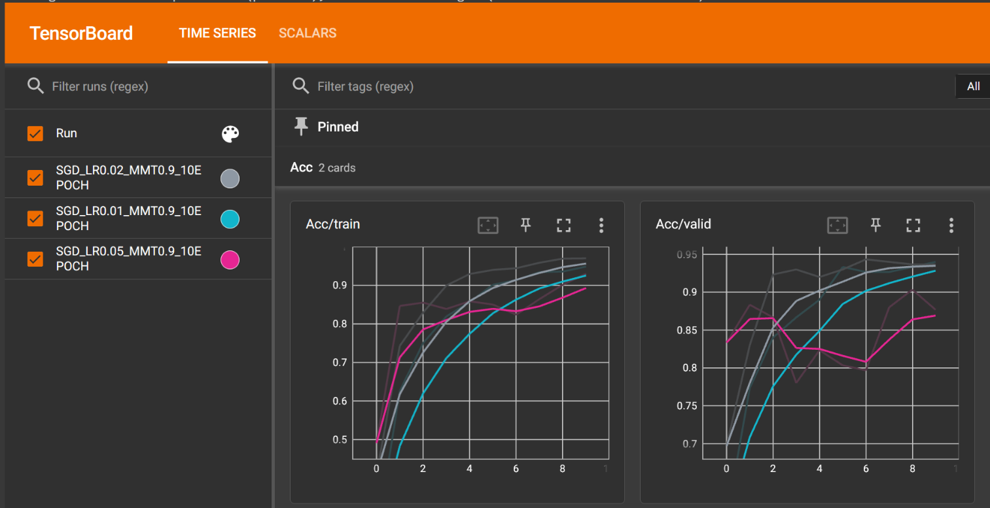
What is tensorboard
Visualization toolkit for machine learning training
Can visualize train/validate loss, accuracy etc.
Benefits in comparing between runs (adjust hyperparameters)

Slide 15
Tensorboard steps
install pip install -qq tensorboard
import summarywriter
from torch.utils.tensorboard import SummaryWriter
create directory to save log files e.g. /content/runs/run1/
instantiate writer writer = SummaryWriter(log_dir="./runs/run1/")
add scalar writer.add_scalar("Name", value, round)
write on disk writer.flush()
close writer.close()
launch tensorboard
%load_ext tensorboard
%tensorboard --logdir runs

Slide 16
References
[1] https://www.tensorflow.org/tensorboard
[2] https://pytorch.org/tutorials/recipes/recipes/tensorboard_with_pytorch.html

Slide 17
WandB
Guide

Slide 18
What is WandB
Special tools by Weights & Biases for
experiments tracking
results visualization
hyperparameter adjustment (sweep)
reproduce models
and more!
Create account https://wandb.ai/site
Get API key (Need when login) https://wandb.ai/authorize

Slide 19
Steps: Dashboard
install !pip install wandb
import import wandb
login wandb.login() # this one is for the imported wandb library
initiate wandb.init( project="Animal-EfficientNetB0", config={"learning_rate": 0.02, "architecture": "EfficientNetB0", "dataset": "Animal2", "epochs": 10} )
log wandb.log({"acc": acc, "loss": loss})
finish wandb.finish()

Slide 20
Steps: Sweep
install !pip install wandb
import import wandb
login wandb.login()
create config (dict) sweep config = dict()
write your own training function train()
write WandB training function on top trainer()
initiate sweep (via wandb agent) wandb.agent(sweep_id, train)
get results at your account page https://wandb.ai/

Slide 21
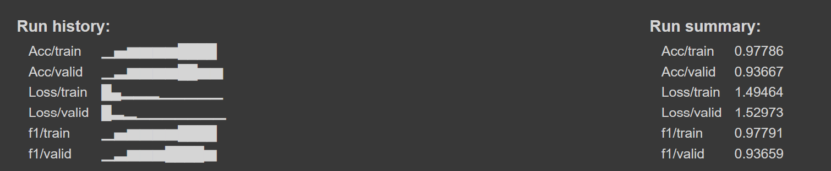
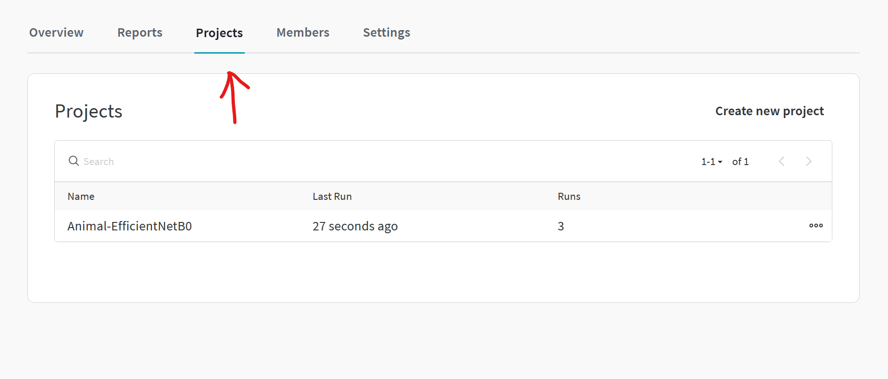
Results
Run history and run summary in your notebook
Full dashboard in your wandb profile

Slide 22
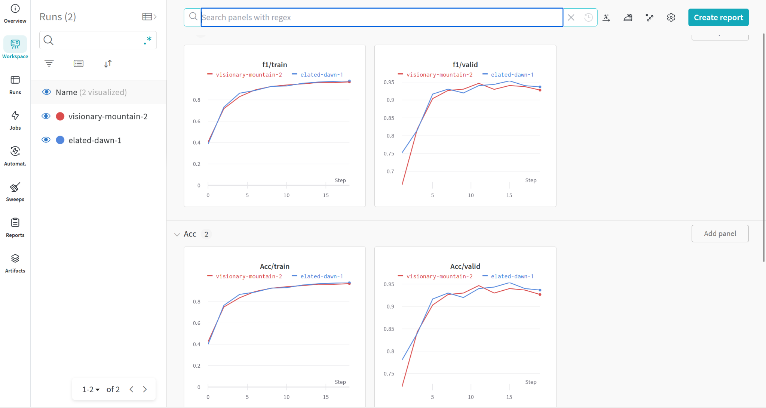

Slide 23
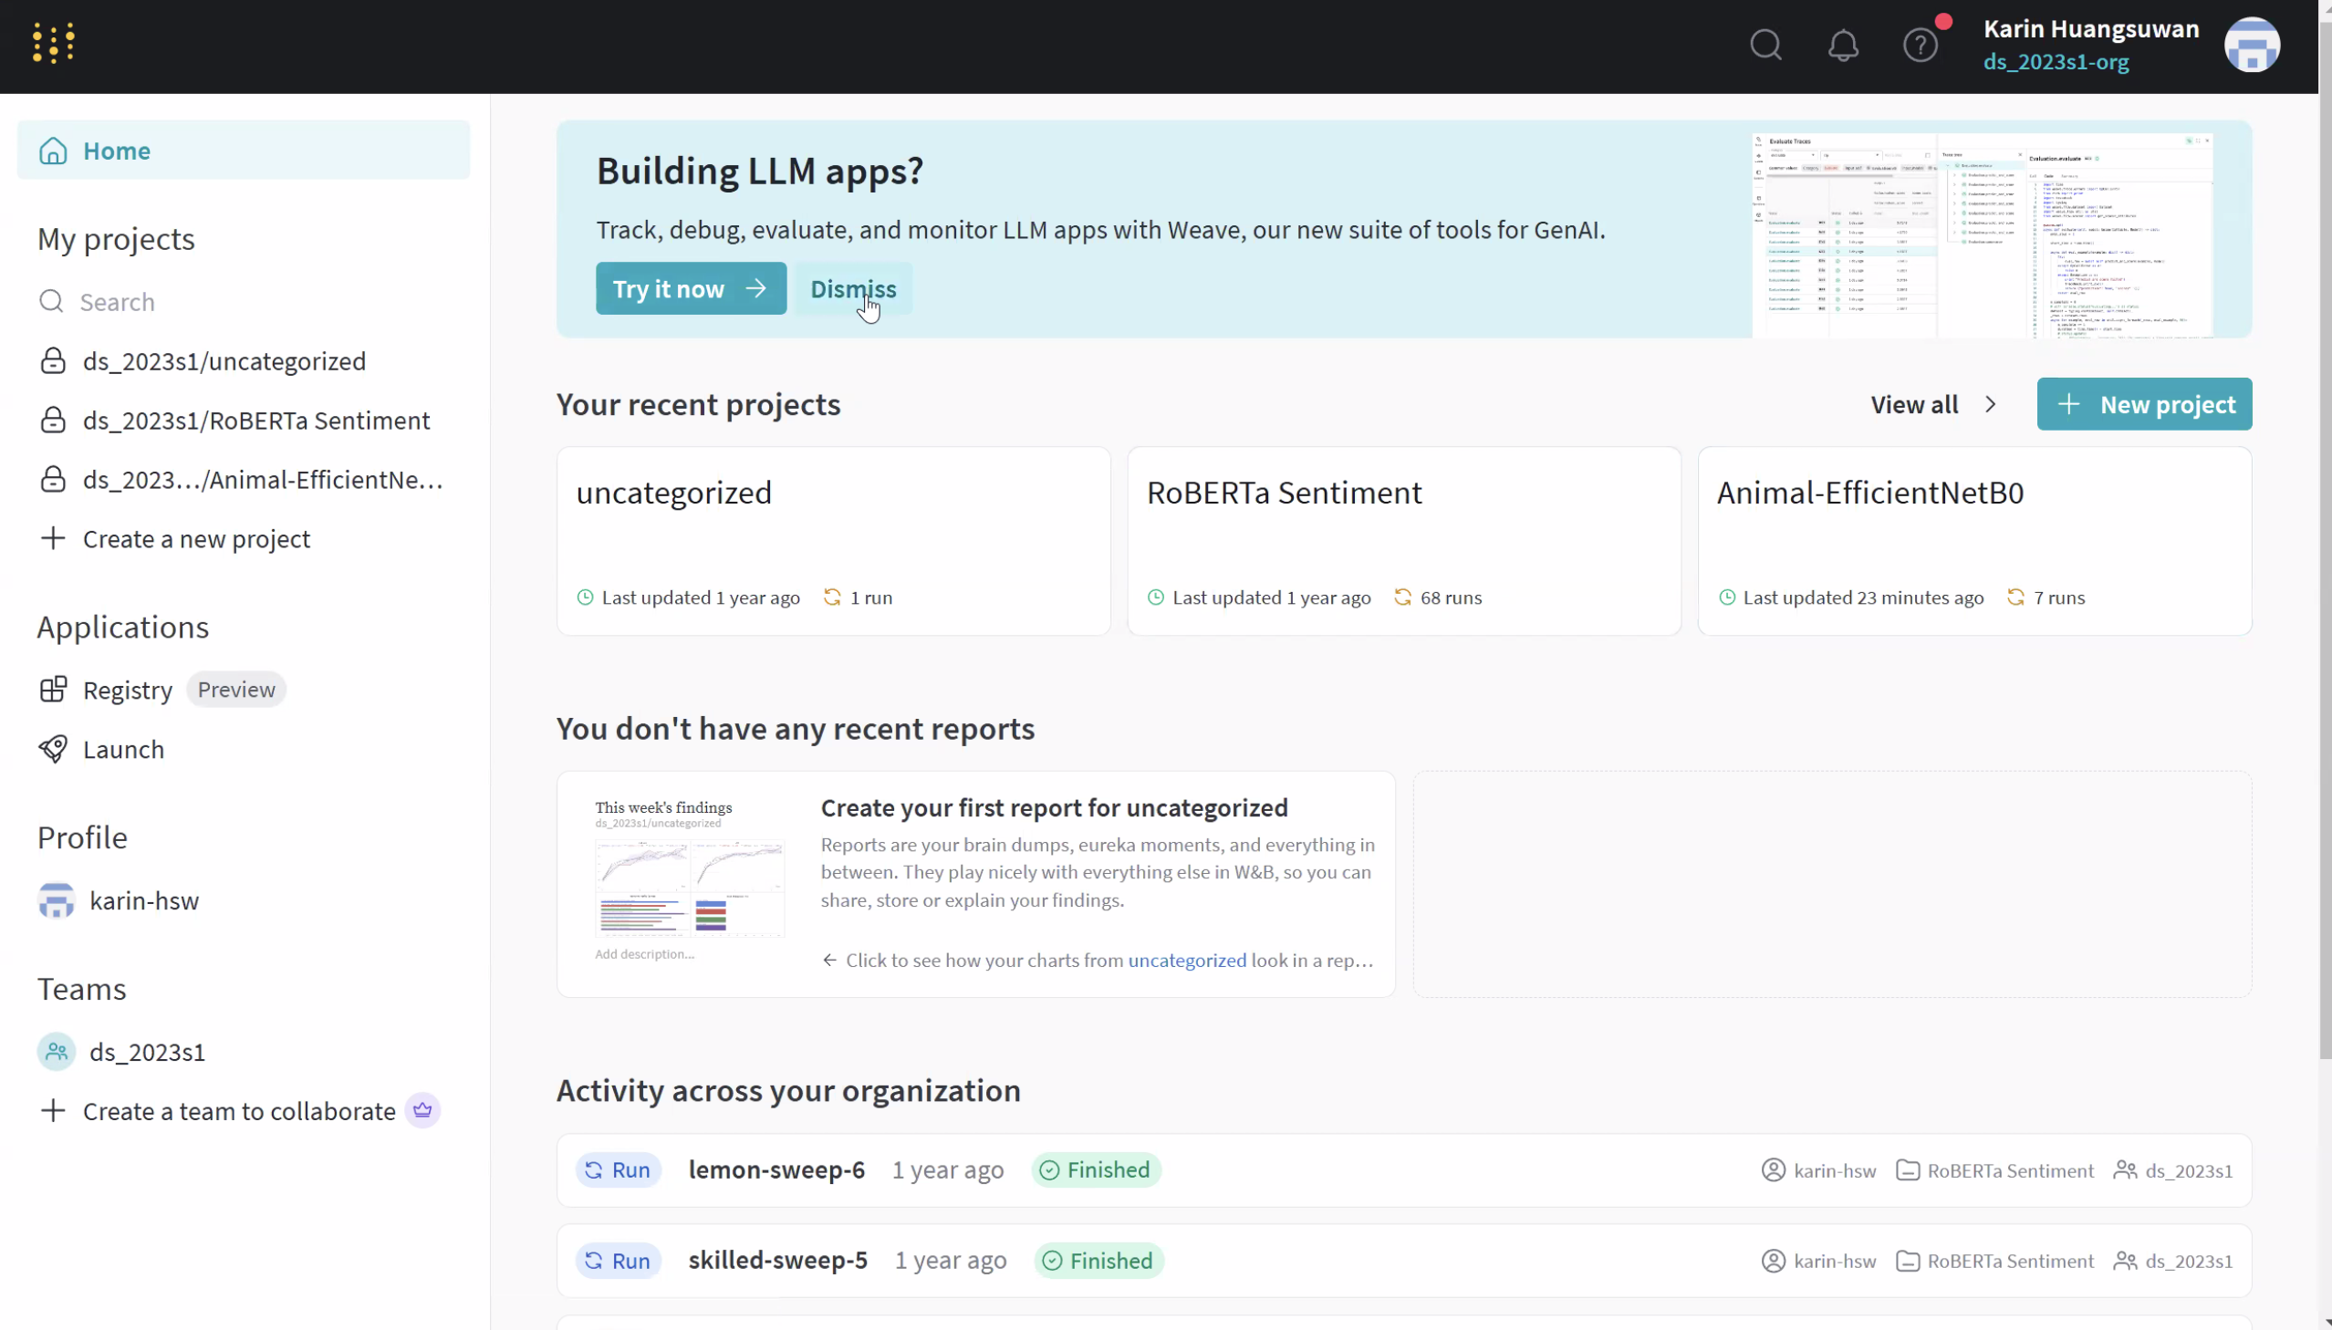
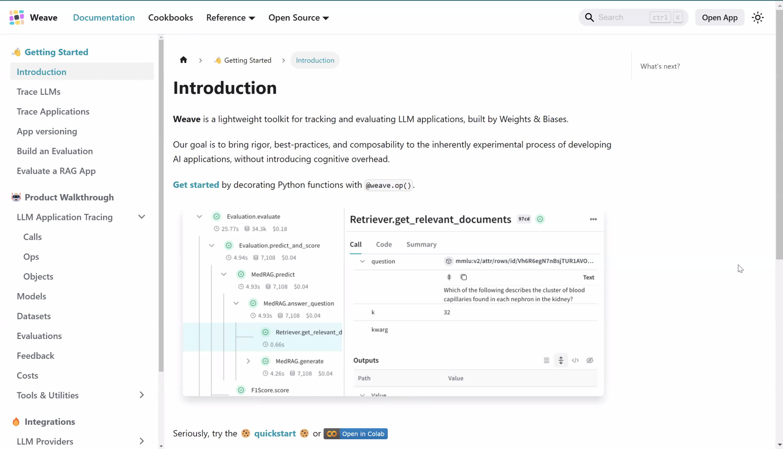
Check this out!
Weave, a toolkit designed by Weights & Biases for tracking and evaluating LLM applications

Slide 24
References
[1] https://wandb.ai/home

